Slide 1



Electrical Engineering Department
JECRC, Jaipur
TESLA 03/18
TESLA 03/18
March
2018

Slide 2

TESLA
03/18
What’s
Inside....??
1. Director’s Message
2. Principal’s Message
3. HOD’s Message
4. Vision, Mission of Institute
5. Vision, Mission of Department
6. Program Outcomes
7. J-Techtrix - Redefine the Possible
8. Renaissance 18
9. Technical Events - Renaissance 2018
10. Student’s Achievements
11. Editorial Board

Slide 3

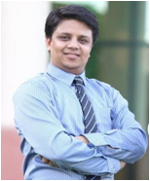

TESLA 03/18
Director JECRC, Jaipur
Message
The JECRC Foundation has been established with a view to provide world class education to our young minds so that they can shoulder their global responsibilities in the years to come.
The JECRC Foundation, now 18 years old, has established itself as one of the leading self-financed colleges in Northen India. This has been primarily due to the large significance that the college puts on the teaching learning process.
The focused areas at JECRC now, apart from teaching learning and placement would be research and development, entrepreneurship and outreach. We also strive to help our students in maintaining and spreading the rich Indian culture and lead the world as our country has done in the past. As you move ahead and rise higher in your life, you must entrench yourself in this unique realm that our culture endows us.
I wish to convey my greetings to all our Alumni and wish each one of them all success in their personal and professional lives.
Best Wishes
Mr. Arpit Agrawal
Director
JECRC, Jaipur

Slide 4
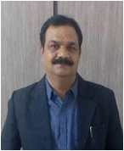
TESLA 03/18
Principal JECRC, Jaipur
Message
A desire can change nothing, a destination can change something but a determination can change everything. Life is a set of problems, an engineer has to solve the problems in their domain areas with strong innovative ideas and scientific knowledge. Your commitment to become an engineer by denoting your journey in Jaipur Engineering College and Research Center will be fruitful and enjoyable in every aspect, the experience you gain from here and the moments you spend here.
Best Wishes
Dr. V. K. Chandna
Principal
JECRC, Jaipur

Slide 5
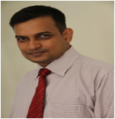
TESLA 03/18
HOD (EE)
JECRC, Jaipur
Message
Nikola Tesla, the well known Serbian- American electrical engineer is quoted as saying "Electrical sources has revealed to us the true nature of light has provided us with innumerate appliances and instruments of precision and has thereby vastly added to the exactness of our knowledge". His words portray the immensely wide and dynamically changing and ever developing world of electrical engineering open to electrical engineer.
It is a great pleasure to see the March, 2018 issue of EE newsletter “Tesla 03/18”. The department has well qualified staff with expertise in Power Systems, Control Systems, Power Electronics and Drives, Electrical Machines and Renewable Energy System assisted by skilled supporting staff. I would like to thank my existing team for their commitment and hard work. The department seeks to combine excellence in education and research. The core values of the department help the students to develop the students their overall personality and made them worthy technocrat to compete and work at global level. Our department has been conducting hands on workshop/seminar/training program since its beginning to keep the faculty and students to enhance the knowledge in their domain.Our mission includes a commitment to prepare students for professional and research activities with an ability to learn independently. I wish you all a successful, long-lived, engineering-based career path.
Best Wishes
Dr. Sandeep Vyas
HOD, Electrical Engineering
JECRC, Jaipur

Slide 6

Vision of the Institute
TESLA 03/18
To become a renowned centre of outcome based learning, work towards academic, professional, cultural and social enrichment of lives and communities .
Mission of the Institute
Focus on evaluation of learning outcomes and motivate student to inculcate research aptitude by project based learning.
Identify, based on informed perception of Indian, regional and global needs, the areas of focus and provide platform to gain knowledge and solution.
Offer opportunities for interaction between academia and industry.
Develop human potential to its fullest extent so that intellectually capable and imaginatively gifted leaders may emerge in the range of profession.

Slide 7
Vision of Department
TESLA 03/18
To Emerge as a Centre of Excellence in teaching in the area of Electrical Engineering; to serve as a valuable resource for society by promoting excellence.
Mission of Department
M1: To provide professional and ethical guidance to the students to make them employable .
M2: To improve quality of education through different quality development programs for faculty and students .
M3: To encourage students to acquire practical knowledge through projects and participation in national and international events .
M4: To prepare our students for upcoming challenges of life through guidance for competitive examinations .
4

Slide 8
TELSA
03/18
PROGRAM OUTCOMES
Engineering knowledge: Apply the knowledge of mathematics, science, engineering fundamentals, and an engineering specialization to the solution of complex engineering problems.
Problem analysis: Identify, formulate, research literature, and analyze complex engineering problems reaching substantiated conclusions using first principles of mathematics, natural sciences, and engineering sciences.
Design/development of solutions: Design solutions for complex
Engineering problems and processes that meet the
design system components or specified needs with appropriate
consideration for the public health and safety and the cultural, social, and environmental considerations.
Conduct investigations of complex problems: Use research-based knowledge and research methods including design of experiments, analysis and interpretation of data, and synthesis of the information to provide valid conclusions.
Modern tool usage: Create, select, and apply appropriate techniques, resources, and modern engineering and IT tools including prediction and modelling to complex engineering activities with an understanding of the limitations.
The engineer and society: Apply reasoning informed by the contextual knowledge to assess societal, health, safety, legal and cultural issues and the consequent responsibilities relevant to the professional engineering practice.
4

Slide 9
TESLA 03/18
Environment and sustainability: Understand the impact of the professional engineering solutions in societal and environmental contexts and demonstrate the knowledge of and need for sustainable development.
Ethics: Apply ethical principles and commit to professional ethics, responsibilities and norms of the engineering practice.
Individual and team work: Function effectively as an individual and as a member or leader in diverse teams, and in multidisciplinary settings.
Communication: Communicate effectively on complex engineering activities with the engineering community and with society at large, such as, being able to comprehend and write effective reports and design documentation, make effective presentations and give and receive clear instructions.
Project management and finance: Demonstrate knowledge and understanding of the engineering and management principles and apply these to one’s own work, as a member and leader in a team, to manage projects and in multidisciplinary environments.
Life-long learning: Recognize the need for, and have the preparation and ability to engage in independent and life-long learning in the broadest context of technological change.
4

Slide 10
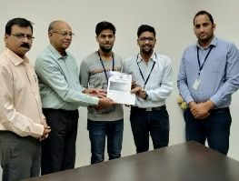
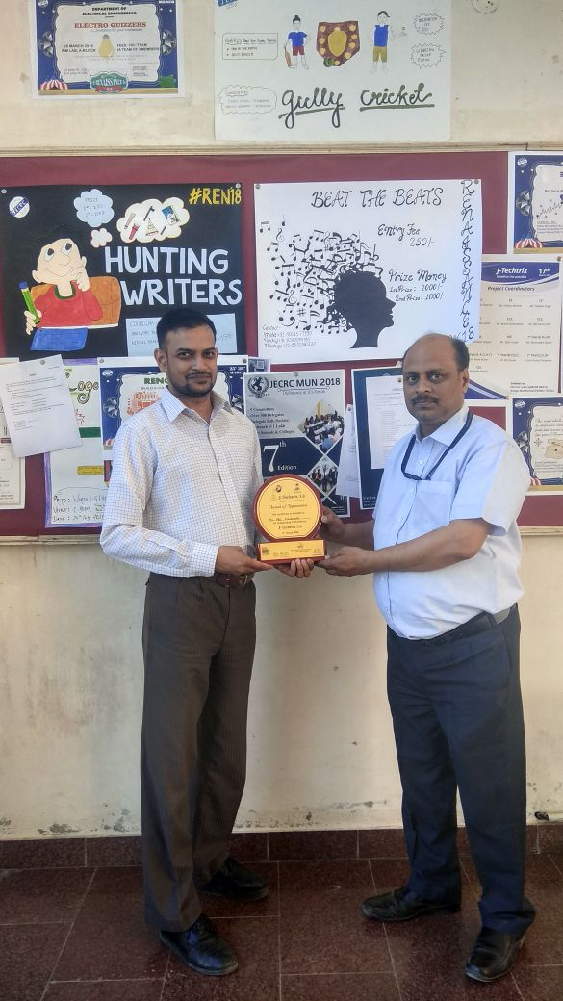
TESLA 03/18
J -TECHTRIX-Redefine the Possible
With an endeavor to promote scientific attitude among the fanatic young minds, the Electrical Engineering Department of Jaipur Engineering College And Research Centre (JECRC) had organized a technical event “J -TECHTRIX-Redefine the Possible" on 17th of March, 2018.The key objective is to bring out the hidden talents and inculcate technical knowledge in students. This project exhibition focuses on encouraging the innovations within students. The event was coordinated by Mr. Vishnu D. Sharma (Assistant Professor). For expert supervision, Prof. Sanjeev Kumar and Prof. Sandeep Jain were the judge for the day.
The outcome of the PROJECT EXHIBITION was that students were able to show their project at higher level and the process boosted their confidence. 11 teams participated in this event.
Winners:
First Prize - Nitish Kumar & team (Prize money - 1100/-)
Second Prize - Ujjwal Soni & team (Prize money - 700/-)
Third Prize - Shubham Bansal & team (Prize money - 500/-)
4

Slide 11
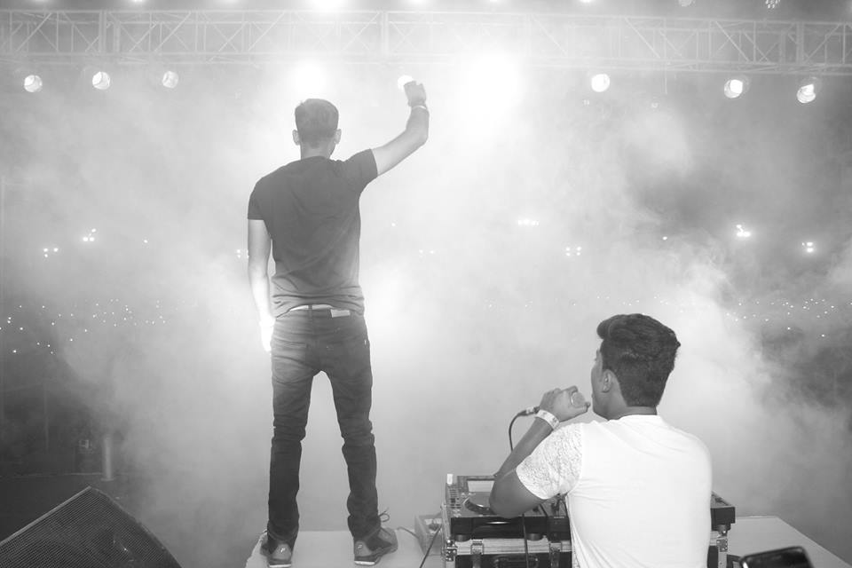
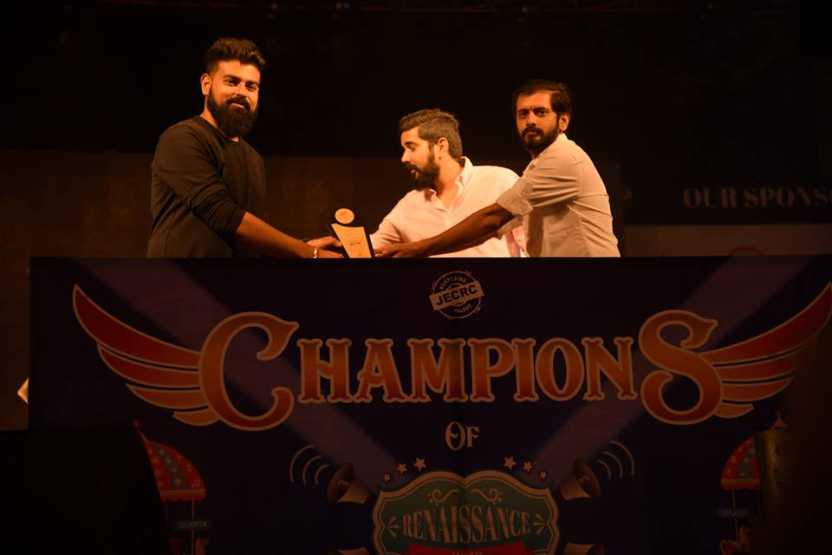
TELSA 03/18
RENAISSANCE 18
Renaissance is a Techno/Cultural fest which provides a big platform for all the students to learn a lot and become multidimensional. The present competitive world demands leaders, entrepreneurs and not simply executives and technocrats. Renaissance acts as a environment, where students learn qualities like coordinating, organizing, pursuing, managing and celebrating which are the qualities of entrepreneurs and leaders. Renaissance is an opportunity, a privilege and an honour bestowed on every student.
Renaissance is an hour which provides that special edge and makes every student strong and competent to face the world. It also provides a big platform for more than five hundred colleges witnessing a congregation of nearly seven thousand students and others from all over the country.

Slide 12
TESLA 03/18
TECHNICAL EVENTS - RENAISSANCE 2018
Renaissance 2018 was a big success. Department of Electrical Engineering organized various technical events for the beneficial of the students. Certificates as well as cash prizes were offered to students. A huge number of registrations were recorded from the Department of Electrical Engineering in these events.
GIZMO – A Paper Presentation Event
The students of the Department of the Electrical Engineering voluntarily took up the initiative to organize the GIZMO (Embryo) under the supervision of Mr. Gopal Tiwari (Assistant Professor), Mr. Ram Singh (Assistant Professor), Ms. Neha Agarwal (Assistant Professor) under the guidance of Dr. Sandeep Vyas (Associate Professor and Head of the Department). JECRC strives to engineer a better world by inspiring, Informing and influencing its members, engineers and technicians. This event was organized in JECRC conference hall A block from 11:00 Am to 4:00 Pm on 25, March 2018. Total 32 teams participated in this event.
Winners:
First Prize – Prakhar Joshi (3rdyr. EE), Shipra Sharma (3rdyr. CSE) won the certificate with cash award of Rs 1100 and Momento.
Second Prize – Preyas Garg (2nd yr CSE), Deepak Paliwal (3rd yr EE) won the certificate with cash prize of Rs 1000 and Momento.
4

Slide 13
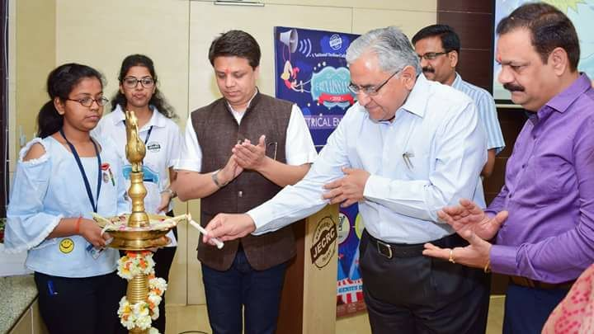
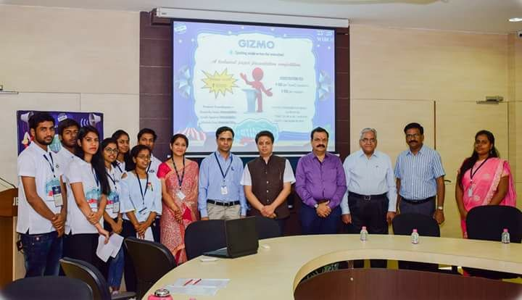
TESLA 03/18
Students Coordinators were Akanksha Sinha, Mridula Soni, Ayush Agarwal, Arpit Jain, Sangeeta Sharma, Ranjeet Singh, Ashish Agarwal, Isha Jain, Mansi Sharma and Roshan Jain
TECHNOWORD CONTEST
To check the practical knowledge of the young minds, an amazing technical event TECHNOWORD CONTEST was organized on the on the 25th of March, 2018 in BLG 13 from 12:30 PM to 3:30 PM for the students of Electrical Department. The event was coordinated by Mr. Sunil Kumar Sharma (Assistant Professor), Mr. Atul Kulshrestha (Assistant Professor) and Mr. Manish Pal (Assistant Professor) under the guidance of Dr. Sandeep Vyas (Associate Professor and Head of the department). Total 27 teams participated in this event.
Winners:
First Prize – Abhishek khandelwal, Anshul Tailor, Yash Gautam (2ndyr. EE) won the certificate with cash award of Rs. 1100/- and memento.
4

Slide 14
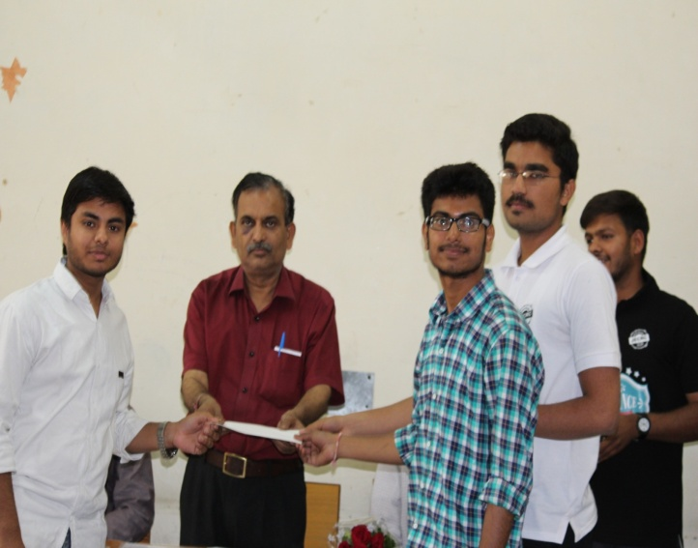
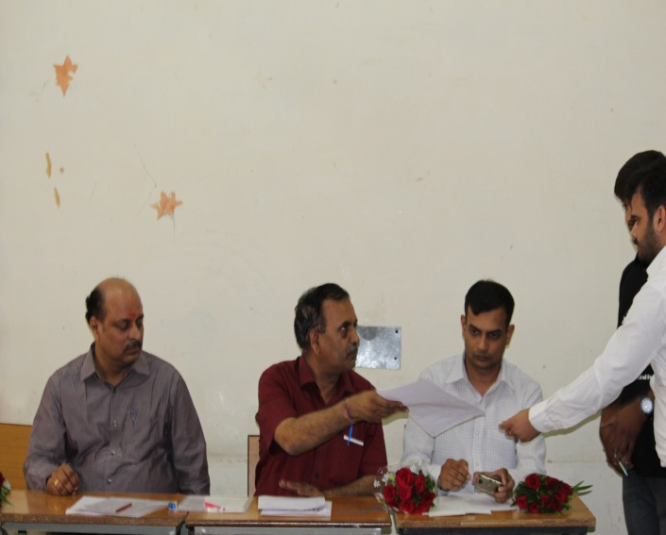
TESLA 03/18
Second Prize – Neelansh Mittal, Nishant Jain, Nishu Jain (2ndyr. EE) won the certificate with cash award of Rs. 500/- and memento.
Students Coordinators were Rohit kumar Gupta, Sourabh Sharma, Deepak Sharma, Tabish Akhtar, Pooja Goswami, Divyansh Kushwaha and Akshay Sharma.
ELECTRAZONE
The students of Department of Electrical Engineering under the guidance of Ms. Poonam Gupta (Assistant Professor) and Mr. Rahul Kumar Mali (Assistant Professor) voluntarily took up the initiative to organize the Technical event named ELECTRAZONE on the 26th of March, 2018 from 9:30 AM to 12:30 PM in BLG 19. The ELECTRAZONE event showcased the very essence of electrical knowledge about house wiring of the participants. Total 34 teams participated in this event.
4

Slide 15
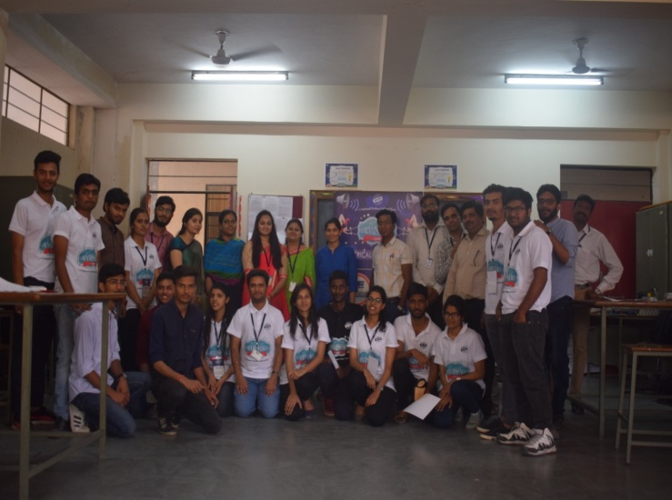
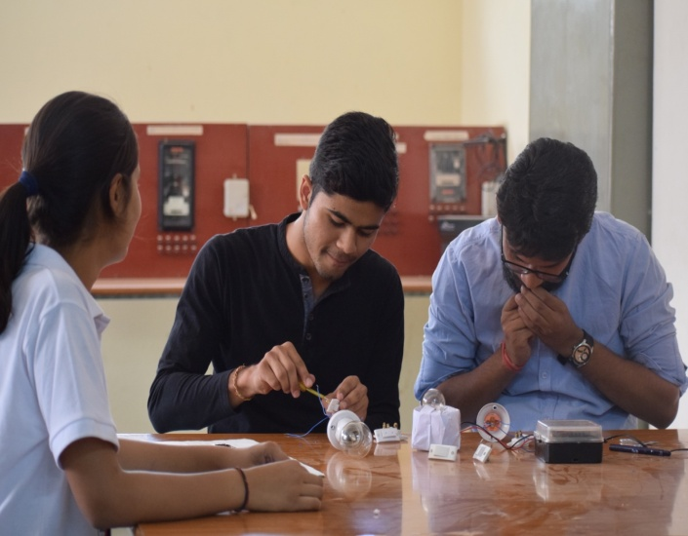
TESLA 03/18
Winners:
First Prize – Tarun Lawaniya (2rd yr. EE), Nitin Mangal(2rd yr. EC) won the certificate with cash award of Rupees 1100/- with momento.
Second Prize – Vishal Mangal (4thyr EE), Mukul Bhardwaj (4th yr. EE) won the certificate with cash award of Rupees 700/- with momento.
Students Coordinators were Nikhil Bindal, Devesh Gupta, Somya Paliwal, Shaiphali Jain, Isha Jain and Anurag Sharma.
ELECTROQUIZZERS
ELECTROQUIZZERS was conducted in the IBM Lab A Block by the Department of Electrical Engineering of Jaipur Engineering College and Research Centre on 26th March 2018. The quiz was organized in a very interactive way and the teams participated with great enthusiasm. The event consisted of paper pen MCQ round, rapid fire round and an audio round including mix bag of questions on technical and non-technical background.
4

Slide 16
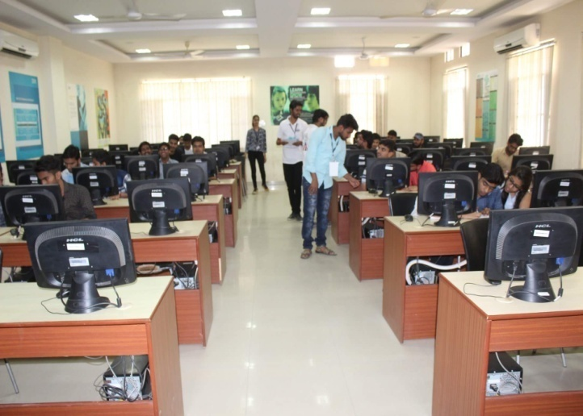
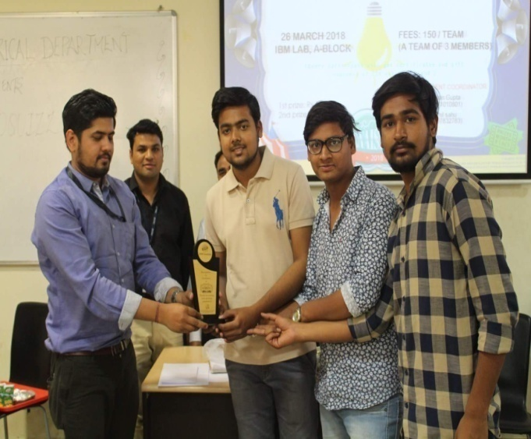
TESLA 03/18
It was a close tussle among the teams and the teams answered with great confidence.
Winners:
First Prize – Keshav Maheshwari and team won the certificate with cash award of Rupees 1100/- with momento.
Second Prize – Ajay Garg and team won the certificate with cash award of Rupees 500/- with momento.
Students Coordinators were Nikhil Sahu, Hemant Singh, Mahendra Khedia, Pankaj Sharma, Bhanu Khandelwal and Aman Gupta.
DRISHYAM – Poster Presentation
This event held on 27th,March 2018 between 9:30 AM to 12:30 PM in BLG 13 under the supervision of Mr. Rahul kumar Mali (Assistant Professor) and Mrs. Ravita Saraswat (Assistant Professor). This event was based on the theme of Energy and Environment. 22 teams were registered for the event.
4

Slide 17
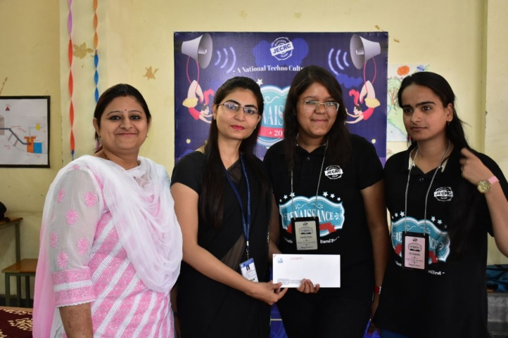
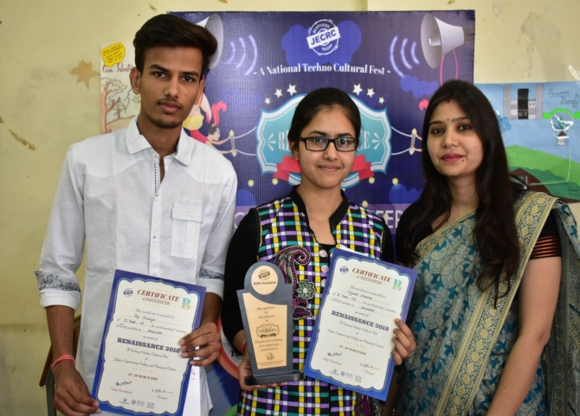
TESLA 03/18
Winners:
First Prize – Eti Sharma and Sakshi Goyal (3rd yr. EE) won the certificate with cash award of Rupees 1100/- with momento.
Second Prize – Ujjwal Sharma and Raj Purbiya (2nd yr. EE) won the certificate with cash award of Rupees 500/- with momento.
Students Coordinators were Sangeeta Sharma, Prachi Vyas, Lakshay, Pramod Kumar, Mahipal, Bharti Sharma and Harshit Sharma.
TECH HUNT
The students of the Department of the Electrical Engineering voluntarily took up the initiative to organize the TECH HUNT under the supervision of Ms. Neha Agrawal (Assistant Professor) and Ms. Geetika Mathur (Assistant Professor) under the guidance of Dr. Sandeep Vyas (Associate Professor and Head of the Department) from 10:30 AM to 1:30 PM in BLG 19 on 27th March, 2018. 21 teams were registered in this event.
4

Slide 18
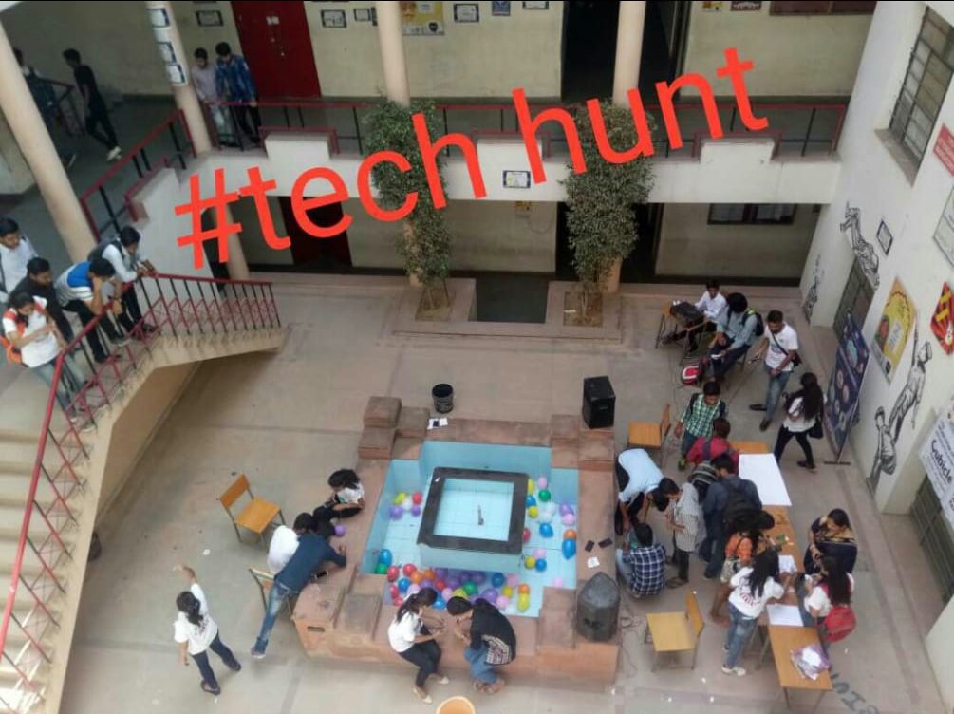
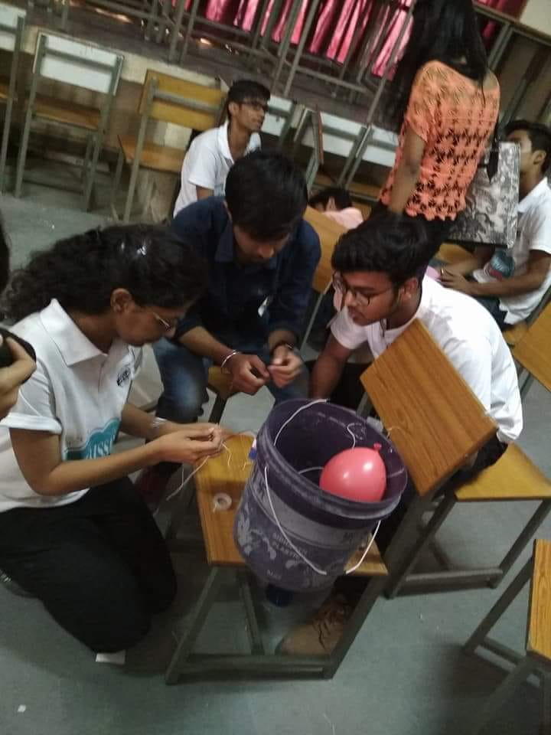
TESLA 03/18
Winners:
First Prize – Somya Paliwal(2rdyr. EE), Shaiphali Jain (2rdyr. EE), Ujjwal Sharma (2nd yr. CSE) won the certificate with cash award of Rupees 2100/- with momento.
Second Prize – Devesh Gupta(2ndyr CSE),Rachit Thakur (2nd yr EE),Devashish Sharma (2nd yr EE) won the certificate with cash award of Rupees 1100/- with momento.
Students Coordinators were Vaibhav Gupta, Amit Mewara, Himani Jharotiya, Anmol Bishnoi, Saurabh Sharma and Ruchika Kholia.
TECHNICAL CROSSWORD
The students of the Department of the Electrical Engineering voluntarily took up the initiative to organize the Technical Crossword under the supervision of Mr. Ashok Singh Chundawat (Assistant Professor) and Ms. Yazusha Sharma (Assistant Professor) from 01:30 PM to 3:30 PM in BLG 13 on 27th March, 2018. 22 teams were registered in this event. This event showed the way to develop self confidence and to do things and get a record of successful experiences .
4

Slide 19
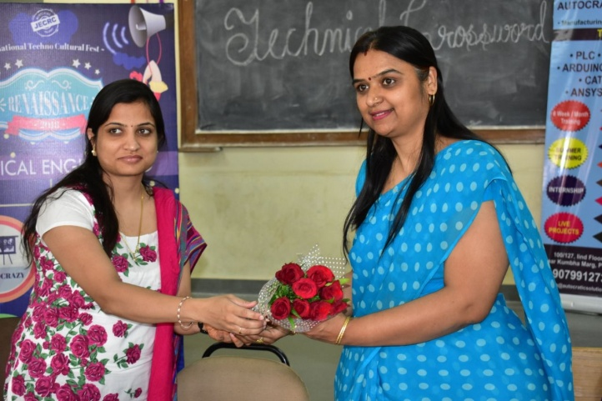
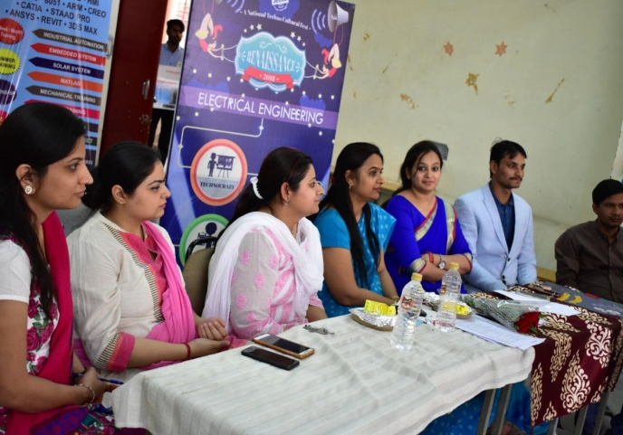
TESLA 03/18
Winners:
First Prize – Nikhil Bindal and team won the certificate with cash award of Rupees 1500/- with momento.
Second Prize – Arusha and team won the certificate with cash award of Rupees 1000/- with momento.
Students Coordinators were Neha agrawal, Nikhil lohar, Shashwat Tripathi, Nirmal lakhara, Padmakshi, Anubhav, Harshit Sharma and Yash gautam
THOUGHT BAZOOKAS
Electrical Department of Jaipur Engineering College and Research Centre organized an event THOUGHT BAZOOKAS to enhance and check the technical skills of the students. The event was successfully organized on 28th March 2018 from 9:30 AM to 12:30 PM under the guidance of Dr. Sandeep Vyas (Associate Professor and Head of the Department) and Mr. Manish Pal (Assistant Professor). The Department successfully fulfilled its dream of inculcating group dynamics, and employable skills through this fun event where students were judges on the basis
4

Slide 20
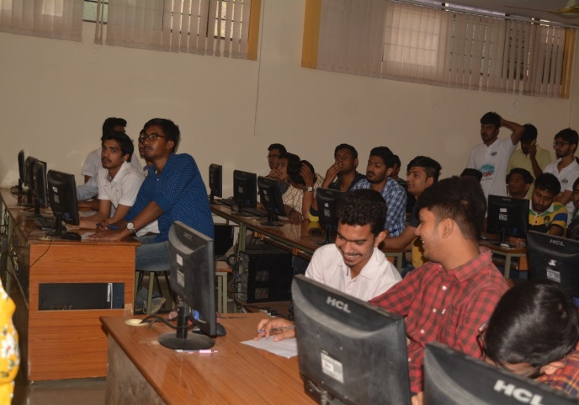
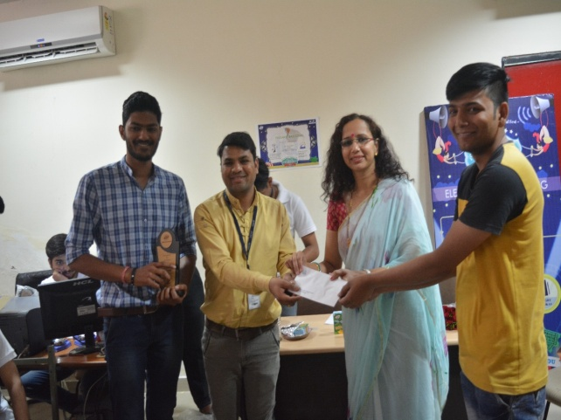
TESLA 03/18
of their general knowledge about various machineries and famous scientists and mathematicians of all times.
Winners:
First Prize – Dixit Parihar and team won the certificate with cash award of Rupees 1500/- with momento.
Second Prize – Shakti and team won the certificate with cash award of Rupees 500/- with momento.
Students Coordinators were Aman Agarwal, Abhishek Agarwal, Yogesh Sharma, Aishwarya Singh Parihar, Ankit Mangal, Anirudh Singh, Ashu Makkar and Inshira Shirin.
TECHNOCRAZY
This event held on 28th,March 2018 between 1:30 PM to 3:30 PM in HVE Lab under the supervision of Mr. L. Senthil (Assistant Professor) and Mrs. Sonali Chadha (Assistant Professor). 24 teams were registered for the event. There were 27 teams ( 2-4 members in each team) participated in event .
4

Slide 21
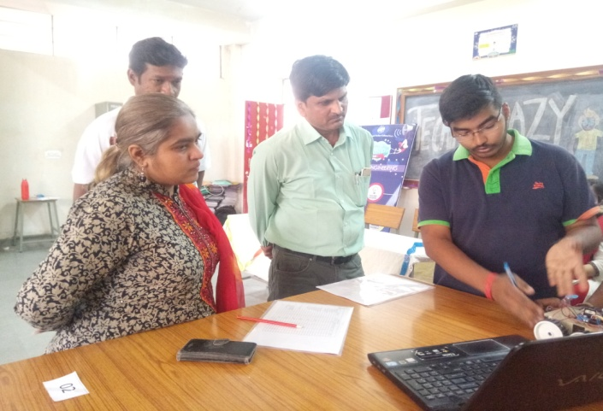
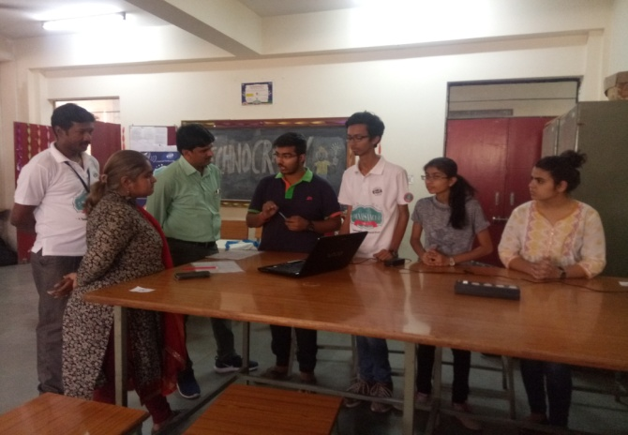
TESLA 03/18
Winners:
First Prize – Anshul Goyal, Kapil Mittal and Arun Gehlot(4th Yr. EE) won the certificate with cash award of Rupees 2100/- with momento.
Second Prize – Alkesh Srivastava, Ashish Tanwar and Mukul Bhardawaj ,Vishal Mangal, Vivek Agarwal (2nd Yr. EE) won the certificate with cash award of Rupees 1100/- with momento.
Students Coordinators were Venugopal Gautam, Vaibhav Jain, Himank Kumawat, Himani Jharotiya, Himanshu Jain and Kanika Khandelwal.
4

Slide 22
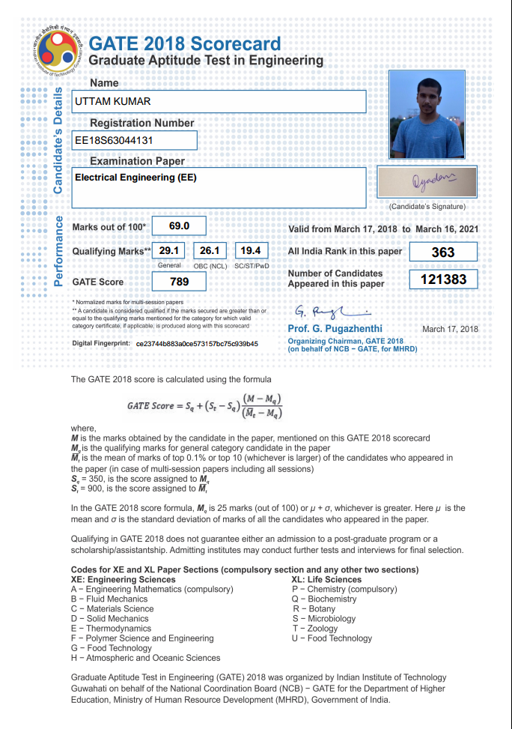
TESLA 03/18
STUDENT ‘S ACHIEVEMENTS
Mr. Uttam Kumar (4th Year) has secured 363 AIR in GATE 2018 and his score is 789.
Mr. Dixank Dwivedi, Ms. Kritika Khandewal, Mr. Hemendra Singh and Ms. Hemlata Tanwar from 4th year in the Department of Electrical Engineering have participated in “AAKAR EXPO 2K18” an IETE Project Competition held at Poornima College of Engineering on 22nd , March 2018. They have presented project entitled “Smart Card Based Security System”.
4

Slide 23
TESLA 03/18
Mr. Akash Soni, Mr. Dixit Parihar, Mr. Aman Agrawal, Mr. Amit Singh, Mr. Anirudh Singh and Mr. Divyanshu Saini from 3rd Year in the Department of Electrical Engineering have participated in “Smart India Hackathon 2018” in Ahmedabad among 65 teams. Their team name was NCODERS and their problems was “Optimal Connectivity of Unconnected Villages through Roads in Rural Area (Uttarakhand)”.
4

Slide 24
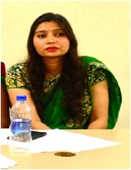
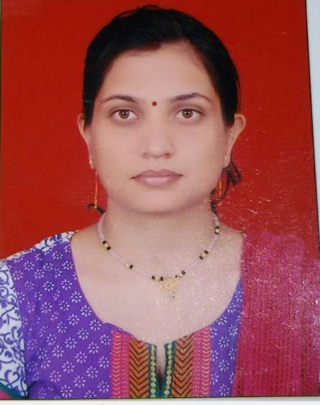
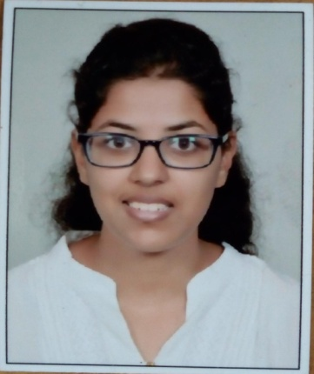
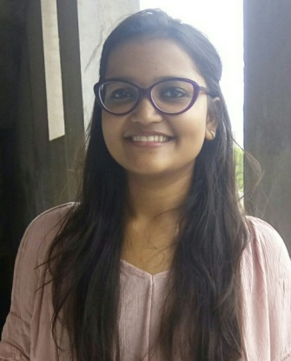
TESLA 03/18
EDITORIAL BOARD
Faculty Coordinators
Ms. Ravita Saraswat
Ms. Yajusha Sharma
Student Coordinators
Isha Jain
(2nd year)
Kanika Khandelwal (2nd year)

Slide 25
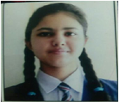
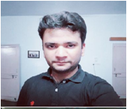

TESLA 03/18
Ujjwal Sharma (2nd year)
Shashwat Tripathi (2nd year)

